Slide 1


Robotics Workshop Week 11 Recap / Challenges / Next?
Notes:
Hello everyone, and welcome to the 11th robotics workshop, this will be the final workshop this year.

Slide 2

Today
Looking over all content covered so far
Catching up on any missed workshops
Attempting various challenges
The future of these workshops
Notes:
Today we will be looking over all the content so far to see what you have done or what you have missed.
You will have the choice to catch up on any previous worksheets, do a worksheet again or attempt some new difficult challenges combining the skills across multiple worksheets.
I will also discuss our plans for next semester as well as talking to all of you about what you would like to see next.

Slide 3
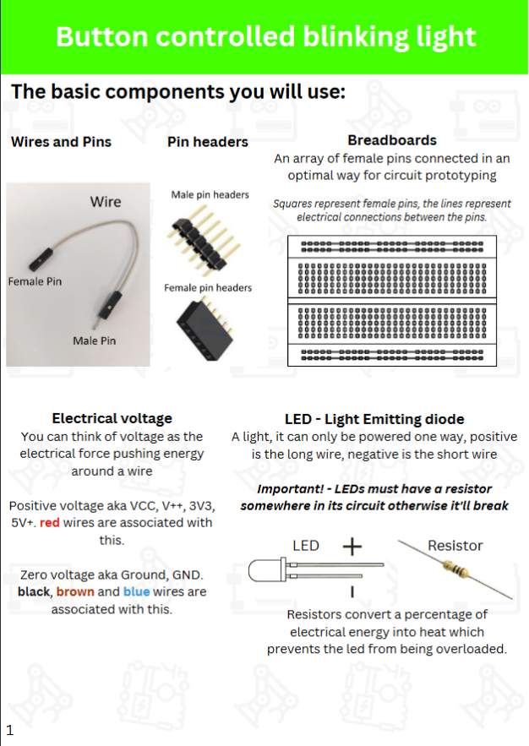
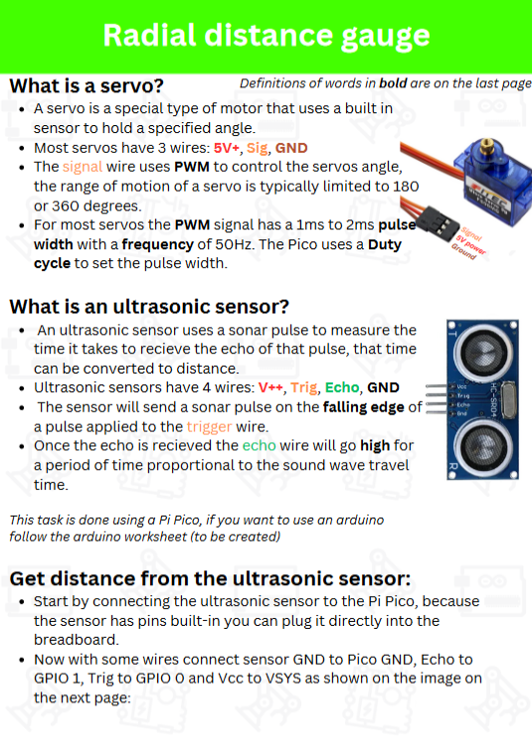
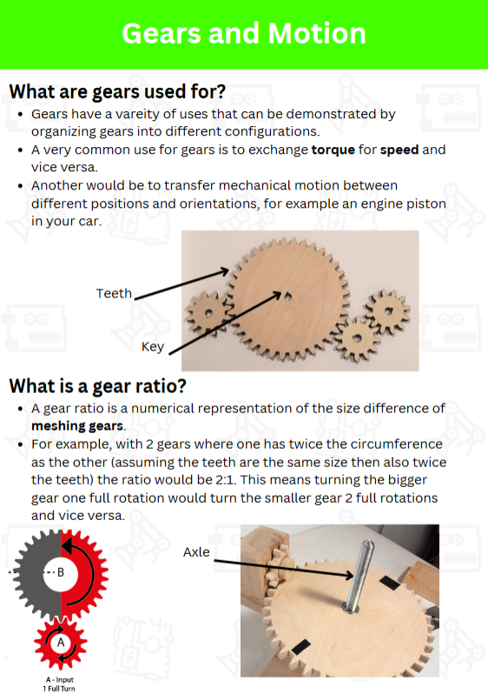
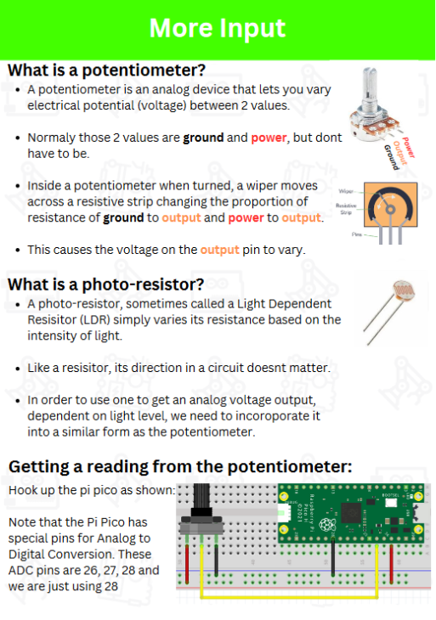
First 4 worksheets
Week 1
Intro to Electronics and
Microcontrollers
-
Made a button controlled blinking light
Week 2
Ultrasonic Sensor
and Servos
-
Made a distance gauge
Week 3
Intro to gears and mechanics
-
Made a mechanical turret
Week 4
Potentiometers and LDR’s
-
Made trailing LED’s
Notes:
So for the first 4 workshops we did all of these.
In the first one we looked at the basics of electronics with Breadboards, LED’s and Resistors, we also looked at how to use a microcontroller. And in the end you made a button controlled blinking light.
In the second one we moved on to some more interesting devices like an ultrasonic sensor and a servo motor to make a distance gauge.
For week 3 we looked at mechanical systems involving gears to make a mechanical turret.
And for week 4 we looked at some analogue input devices like potentiometers and light dependent resistors where we made a bunch of LEDs chase each other.
For week 5 we took a small break to allow everyone to catch up and recap.

Slide 4
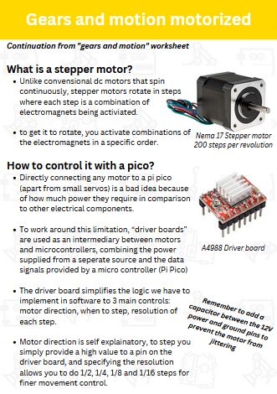
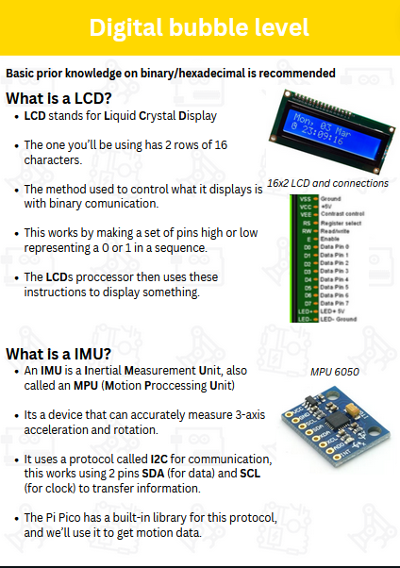
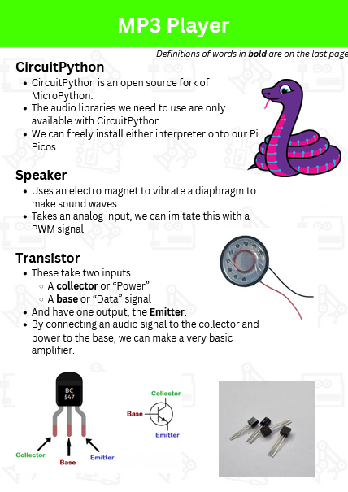
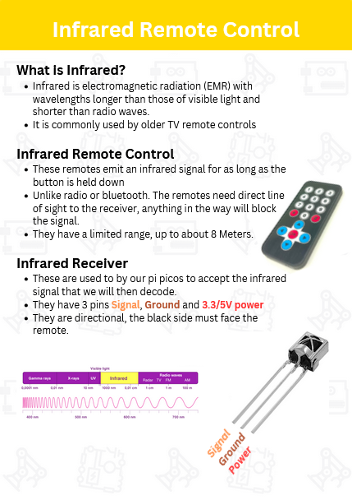
Next 4 worksheets
Week 6
Stepper motors and motor controllers
-
Motorized mechanical turret
Week 7
LCD display and IMUs
-
Made a digital bubble level
Week 8
Circuit Python, transistors and audio
-
Made a mp3 player
Week 9
Infrared transmitter and receiver
-
Remote controlled servo
Notes:
Add images to this slide and next
Add notes here

Slide 5
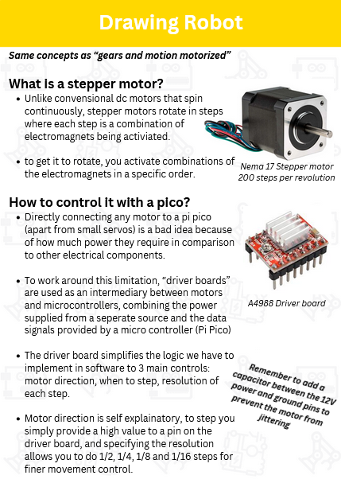
Last worksheet
Week 10
Stepper motors and motor controllers
-
Making a robot draw
Week 11
Recap, Challenges, what’s next?
-
Making stuff
?

Slide 6
What happens next?
Workshops will be happening in the JCW 3D printer lab
Throughout January we will have a few prep sessions to get the room organized
The same workshops will be going ahead next year for anyone new
Those of you that have completed these workshops already will move onto more complex robots and be allowed to work on your own projects
Notes:
JCW 3d printer lab
January prep sessions
After exams, back to normal workshops for new people
And many more weekly sessions to work on more complex robotics projects including personal projects/ideas Involving RC cars/planes/quadcopters.
With enough interest we may start a robotics competition or competitive team.

Slide 7
Today’s Challenges
Make a stepper motor aim in the direction of the breadboard (using the MPU6050)
Make a speaker play music with raw PWM
Get the drawing robot to write your name
Make anything else you can think of!

